Slide 1
Human-Machine Interfaces for Operating a Blimp
Krebs Matthias, Ledergerber Anton
12.06.2012
Supervisors:
Javier Alonso Mora, Konrad Rudin
Notes:
Very welcome to the Bsc Thesis Presentation HMI for operating a Blimp

Slide 2
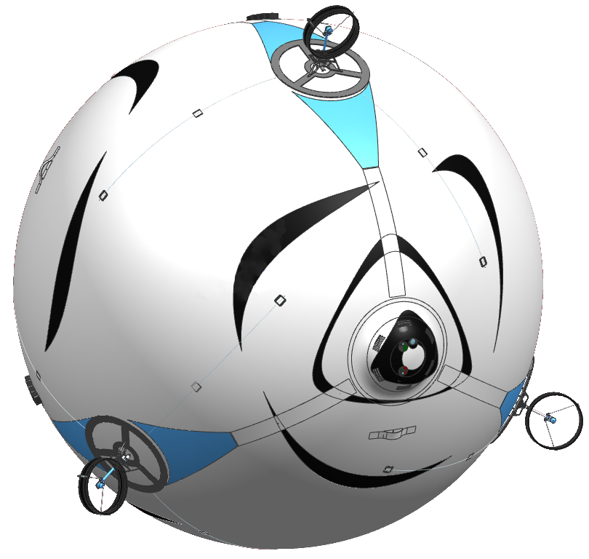
Motivation
One of skye‘s unique properties:
6 controllable degrees of freedom
Develop Control Modes for 6DoF Motion
Realize HMI
Generate 3D Trajectories
4 Motor Platforms
2 DoF each
Control Unit
Accelerometer Gyroscope Magnetoscope Barometer GPS
Communication
Xbee 2.4 GHz Fasst WiFi
Camera System
Notes:
I‘m sure you all know the Focusproject Skye. We did our Bsc Thesis within this project. Skye has four Motorplatforms which can rotate. This makes it possible to contorl all 6 DoF independently. Therefore a good, unique HMI as well as trajectories had to be developed since humans aren‘t used to control 6 DoF.
So our main tasks were to develop different control modes, realize them with a HMI and to generate trajectories.

Slide 3
Control Modes
Overview
Testphase
Direct Control
Assisted Control
Half Automatic
Full Automatic
Development of Project skye
Notes:
As we started from zero, we couldn‘t start with the most advanced Control Mode for steering. Instead we offered a control mode for each stage of the project, adopted at the hard- and software that was ready. In the following the different modes and their implementations are explained.

Slide 4
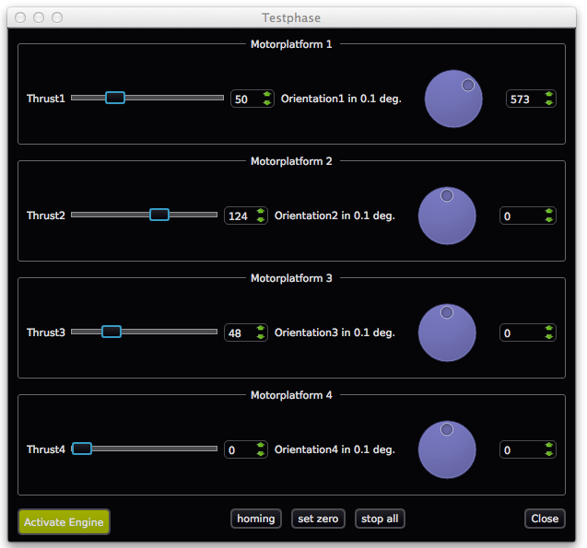
Control Modes
Testphase
T₁
α₁
T₃
α₃
α₂
T₂
8 DoF (Angles, Thrust)
Only for testing
Each Motorplatform is controlled seperately
✔ Tested on real system
Notes:
The first step was to control each motor seperately. Skye has 4 maxons for positioning and for brushless motor for generating the thrust. Once we knew that this mode was working, we could be sure that the hardware was ok. (Here we just offered a simple Widget.) (click) (this mode is tested and working) The next thing to attack was the software....

Slide 5
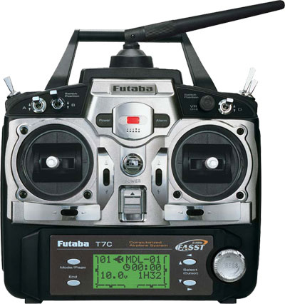
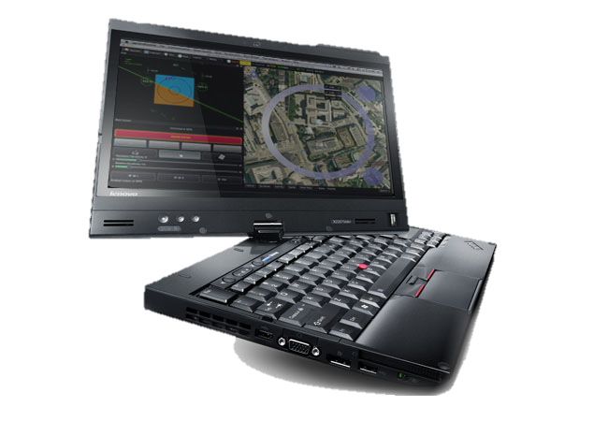
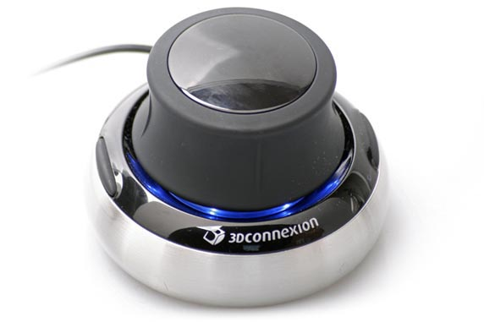
Control Modes
Direct Control
M_{x}^{B}
F_{x}^{B}
e_{x}^{B}
e_{y}^{B}
M_{y}^{B}
e_{z}^{B}
F_{y}^{B}
F_{z}^{B}
M_{x}^{B}
6 DoF
Forces, Moments
✔ Tested on real system
Notes:
DC Mode is simple a feedforward control for all 6Dof, i. e. the moments and the forces. This mode was useful to test the motor allocation without a (high level controler) Most inuitive is to use a 3d space mouse for that. Therefore a interface to QGC was developed with which the 3d mouse could be attached. (click) this is tested and working on the real system.

Slide 6
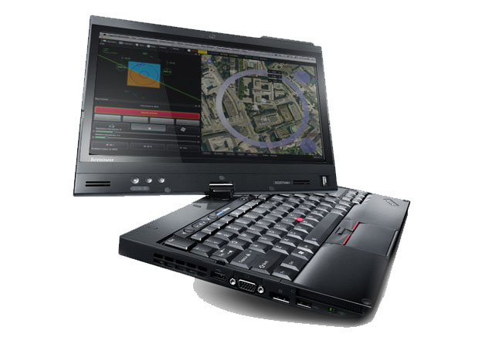
Control Modes
Assisted Control
w_{x}^{B}
v_{x}^{I}
w_{y}^{B}
e_{x}^{B}
v_{y}^{I}
e_{y}^{B}
e_{z}^{B}
v_{z}^{I}
6 DoF
Translational and Angular Velocities
w_{z}^{B}
✔ Tested on real system
Notes:
Once the (high level) controler with feedback was working, we didn‘t want to control skye with forces, but with velocities. Beside the space mouse, a GUI for touchinputs was also wished, here you see it in action. (click)

Slide 7

Control Modes
Assisted Control
Notes:
Once the (high level) controler with feedback was working, we didn‘t want to control skye with forces, but with velocities. Beside the space mouse, a GUI for touchinputs was also wished, here you see it in action. (click) The idea was to control the translational velocities in the inertial frame and the rotational velocities in the body frame. Due to problems with the drift of the magnetoscop and the GPS or the state estimation in general, (click) we only tested it with all inputs in the body frame.

Slide 8
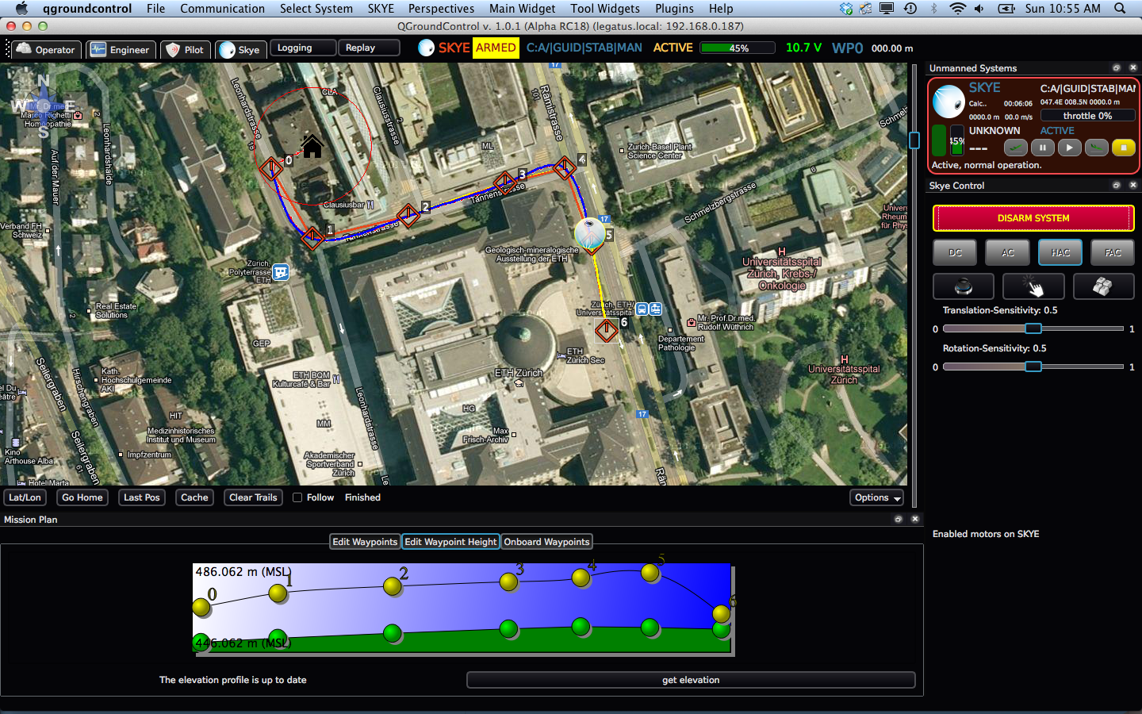

Control Modes
Half Automatic Control
w_{x}^{B}
e_{x}^{B}
w_{y}^{B}
e_{z}^{B}
e_{y}^{B}
w_{z}^{B}
3 manual DoF (Rotational Velocities)
With Trajectory Controller for translational velocities
Pilot controls attitude for taking pictures
✔ Tested in Simulation
Notes:
In order to ease the job of the pilot 3 Dof should be controled automatically. Before the flight the pilot would set the waypoints on google map and afterwards only control the orientation. This mode was thought best for taking high quality images. Here you see a simulation of this mode(click) (click) only tested in simulation since GPS was not yet working.

Slide 9
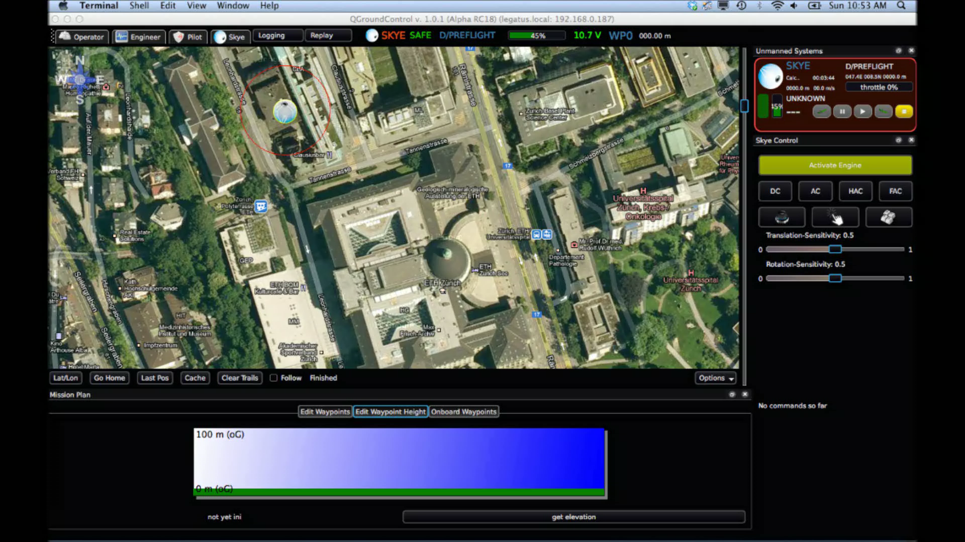
Control Modes
Half Automatic Control

Slide 10
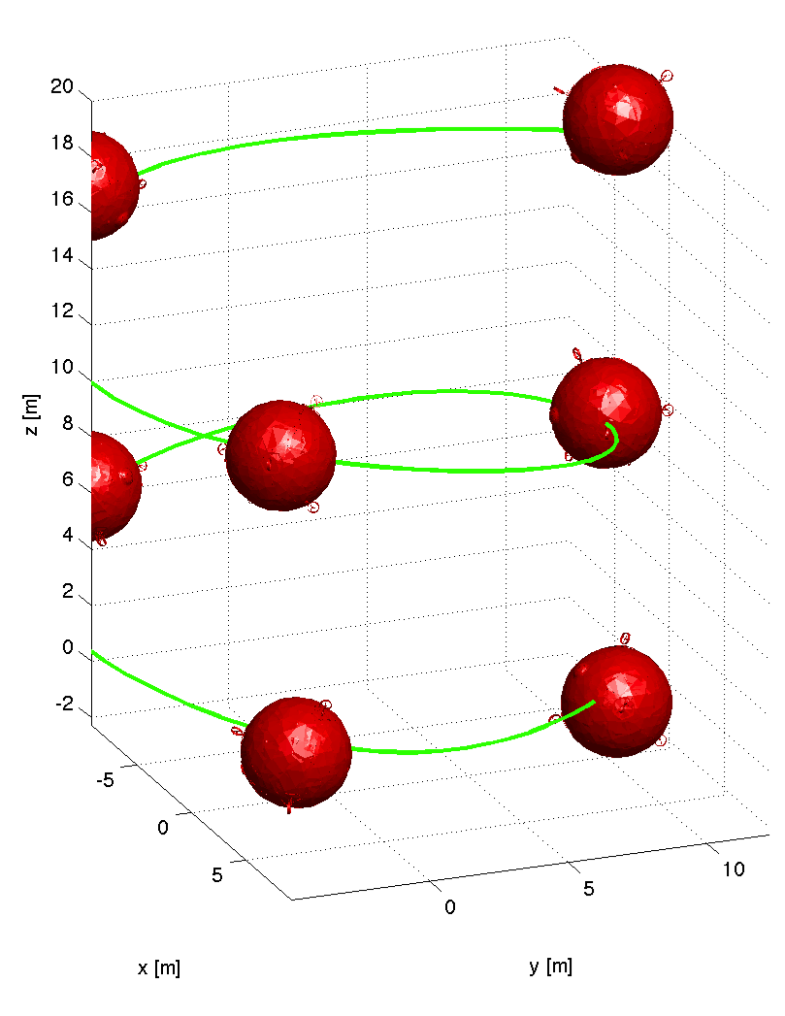
Control Modes
Full Automatic Control
camera target
e_{x}^{B}
e_{z}^{B}
e_{y}^{B}
0 manual DoF
With Trajectory Controller
With set Target Point
Full Automatic
✔ Tested in Simulation

Slide 11
Path/Trajectory
Time Parameterization
Body Frame
Inertial Frame
Notes:
In order to generate a trajectory, first we have to define a parameterized path, here with the parameter u. This parameter will be assigned a time afterwards, such that the system constraints are respected. Combined we have a path with an assigned time at each point, a trajectory in one word, of course this i done for each dimension. Soon it was clear, that we would use splines for the path generation out of waypoints, but what order of spline?

Slide 12
Parameterization
Variants
u₀
u₀
Equally-distant
u₁
u₁
Chord-distant
u₂
u₂
u₃
u₃
Arc-distant
u₄
Centripetal
u₄
u₅
u₅
Notes:
Also the parameterization of the waypoints is of great importance. It affects the shape of the spline on the one hand and through the time assignment the velocity and acceleration on the other hand. Here as an example you see the difference between the equally-distant parameterization, here integers are counted up and the chord distant parameterization, here the chord length between two waypoints are summed up. Compared to the equally distant points the chord-distant points will lead to less acceleration. Beside those two we also had a look at the arc-distant parameterization, where the arc length is calculated and the centripetal parameterization, which takes the square root of the chord distance. Since the centripetal parameterizations offers the best geometrical properties, we propose to use this parameterization although it might not be optimal for the velocity acceleration

Slide 13
Time Scaling
Motion Law
System Constraints
Notes:
So how to we finally assign a time stamp to the geometrical path. Here we went for the constant scaling, meaning that that the relation between the geometric parameter and the time would be linear, and the scaling factor would be defined such that the system constraints will be respected. Here the lambda is the scaling factor. We calculate the first and second derivatives of full path. Then we set lambda such that both the maximal velocity and the maximal acceleration given by our system, are not exceeded. Here in the plot you see that for the circumnavigation of the main building, the maximal velocity ist the limiting factor.

Slide 14
Spline Degree
Continuity
cubic: Continuous in Acceleration
quartic: Continuous in Jerk
quintic: Continuous in Snap
Notes:
If we talk of splines as piecewise polynominals one can imagine that cubic splines will offer continuity up to the second derivative, i.e. the acceleration. This is the least required for 3 D smooth movements. Quartic go a step further and offer continuity for the jerk and quintic for the snap and consider further system dynamics. The question is what degree of continuity do we need?

Slide 15
Spline Degree
Propulsion Dynamics
Consider Propulsion Dynamics?
C² Continuity seems to be sufficient (not considered!)
Decision
Take Cubic since they quartic and quibic tend to oscillate more.
Notes:
In order to find out this we calculated the resulting forces from our trajectory and fed it into the Propulsion System. Should we consider the propulsion Dynamics? The Simulation showed that C2 continuity, i.e cubic splines are sufficient enough, while quartic and quintic spline tend to oscillate more. Therefore we propose to use cubic spline. Still we evaluated all degrees which you will see later in this presentation. (Perhaps once a better system model would be available, and once skye is more agile, this decision would have to be rethought. Beside the Spline Degree)

Slide 16
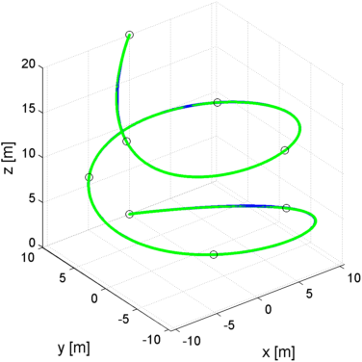
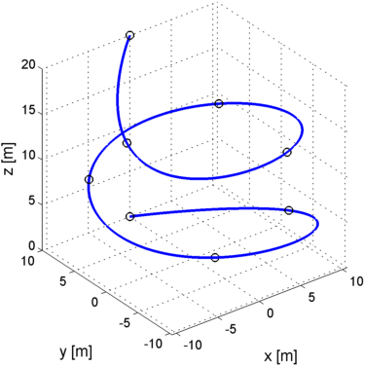
Trajectory-Controllers
Criteria
Precise path tracking
Low power consumption
Time equivalence (trajectory tracking)
Trajectory p(t)
Trajectory Simulation Trace r(t)
Notes:
Then we tested the various trajectories on a EXISTING SIMULATION of SKYE. We have the blue trajectory as reference p(t) and compare it with the trace of skye r(t).
There are three criteria that have to be minimized for a good tracking: The average distance between the PATH and the TRACE, the average ACCELERATION of skye that means minimum power consumption as well as time synchronity.

Slide 17
Trajectory-Control
Controllers
3 different approaches: Trajectory Following Pure Pursuit Cross Track
(Lookahead) (Closest Point)
Trajectory
Pos Control
Skye
Skye
Notes:
Based on the Controller designed by Gian, we set up 3 usually used trajectory controllers.
The first approach is based on fully known system constraints. If the trajectory is within these limits, it is possible to feed in the reference state p(t) for every timestap. [RUN]

Slide 18
Trajectory-Control
Controllers
3 different approaches: Trajectory Following Pure Pursuit Cross Track
(Lookahead) (Closest Point)
Trajectory
Vel Control
Skye
Skye
Notes:
PURE-PURSUIT is based on a Lookahead point. We look for the closest point of the trajectory to the actual position and then head for a lookahead point. The time synchronity is not guaranteed, but the controller is much more robust.

Slide 19
Trajectory-Control
Controllers
3 different approaches: Trajectory Following Pure Pursuit Cross Track
(Lookahead) (Closest Point)
Trajectory
Pos Control
Skye
Skye
Notes:
Finally, CROSS-TRACK ERROR CONTROL works the same way than TRAJECTORY FOLLOWING except that we don‘t persist(?) on time synchronity but always check for the closest point on the trajectory.

Slide 20
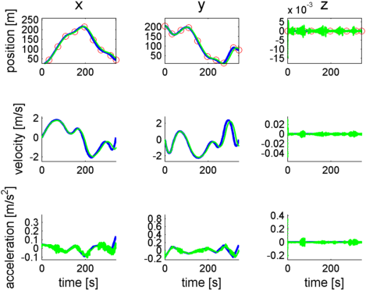
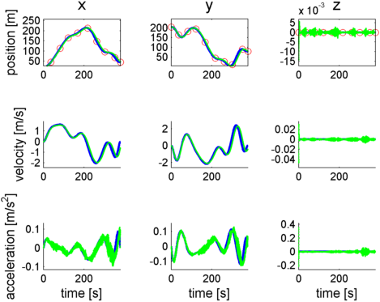
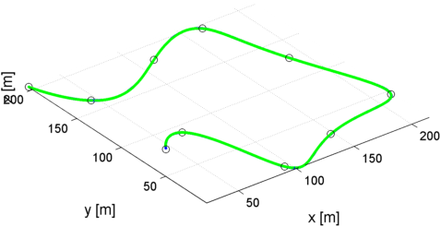
Evaluation
Absolut Results
J1: Average Deviation 0.01 m
J2: Average Acceleration 0.1 m/s²
J3: Used Time +/- 5%
cubic
quintic
Notes:
Let‘s look at the tracking results: The average achieved deviation BETWEEN trajectory and trace is about 10cm. The occuring accelerations are about 10 PERCENT of the limits, and we reach our target point within +/- 5 percent.
This results are TRUE for CUBIC, as well as well for higher spline degrees as QUINTIC.

Slide 21
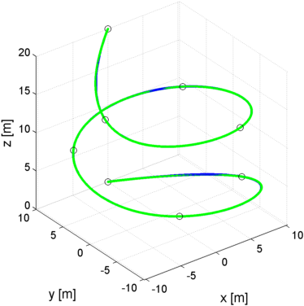
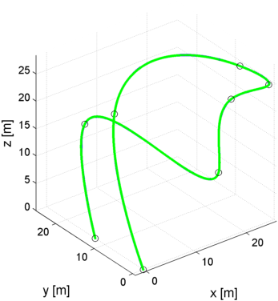
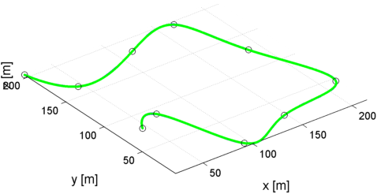
Evaluation
Different Waypoints
Path1
Path2
Path3
„ETH mainbuilding“ „Helix around tree“ „Agil maneuver“
Notes:
All the splines and controllers were tested on different WAYPOINT SAMPLES. The first one is the known SURROUNDING of ETH MAINBILDING with some straight lines, a HELIX with height curvature as well as a MANEUVER combining HEIGHT VELOCITY as well as ACCELERATION.

Slide 22
Evaluation
Performance
Trajectoy Following
Pure Pursuit
Cross Track
Path1
Path2
Path3
Cubic
Quartic
Quintic
No wind, centripetal param.
J1: Average Deviation
J2: Average Acceleration
J3: Time (always exact, not in plot),
Notes:
Now we can compare the performance of the controllers. We compare the average deviation (BLUE) and the average acceleration (RED). Here we have the same conditions given for Trajectory Following CONTROLLER, the PurePursuit as well as the Cross Track Error Controller. We tested it on the THREE MENTIONED PATHS and CUBIC QUINITC and QUARTIC splines.
As we can see, WITHOUT ANY DISTURBANCES, the accelerations are the same for all controllers, and the DEVIATIONS DONT DIFFER THAT MUCH. There are some better results with the CrossTrackError Controller.

Slide 23
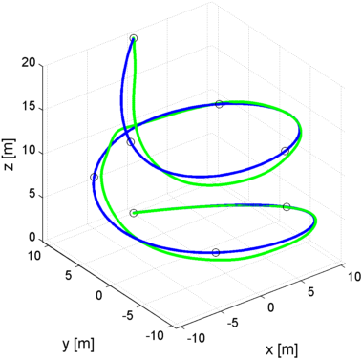
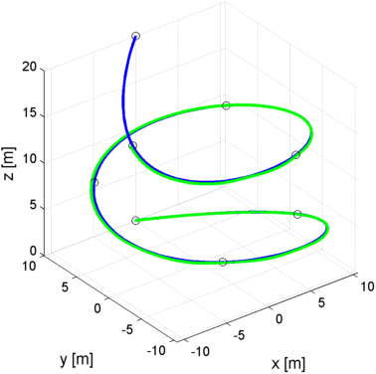
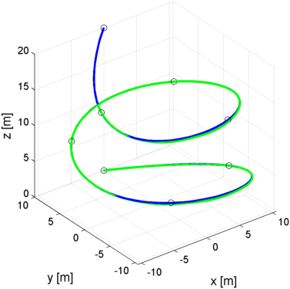
Evaluation
Performance (Wind)
Trajectoy Following
Pure Pursuit
Cross Track
Path1
Path2
Path3
Cubic
Quartic
Quintic
t_{end}
t_{end}
Wind 1m/s, centripetal param.
J1: Average Deviation
J2: Average Acceleration
J3: Time (85-95%, not in plot),
Notes:
The results totally change if we apply some wind to the simulation. Here we used constant wind of about 1m/s. The TRAJECTORY CONTROLLER cant follow the path anymore, there are big deviations. [CLICK] But while it reaches the end within the given time, the other two controllers are about 10% slower end only here..

Slide 24
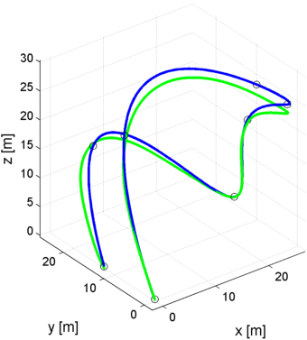
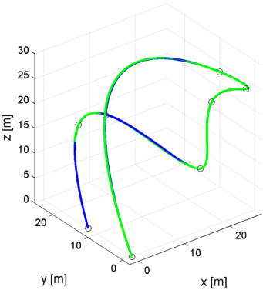
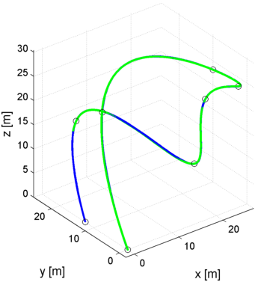
Evaluation
Model uncertainties
Trajectoy Following
Pure Pursuit
Cross Track
Perfect Model » 15% Uncertainties in System Constraints
Deviation: 0.010 » 0.849m 0.014 » 0.041m 0.006 » 0.069m
Acceleration: 0.114 » 0.239m/s² 0.110 » 0.181m/s² 0.109 » 0.188m/s²
Notes:
The same is valied for MODEL UNCERTAINTIES. The Trajectory Controller is - DUE TO LACK OF ROBUSTNESS – not able to keep the track, while the other two controllers are more robust

Slide 25
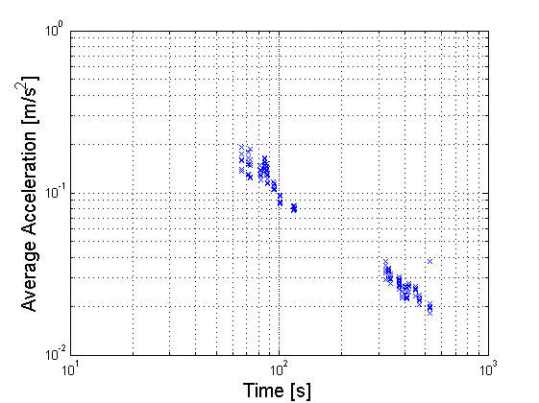
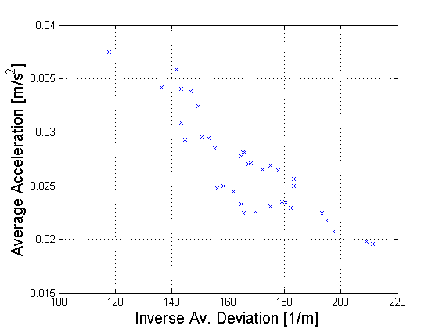
Evaluation
Correlation
The faster the way, the higher the accelerations
Higher accelerations lead to higher deviations
cubic
quartic
quintic
Notes:
We could also observe some OBVIOUS CORRELATIONS. On this logarithmic plot we can see that if a PATH is flown faster, the occuring Accelerations will increase.
The second one shows a clear correlation between accelerations and deviations BETWEEN TRACE AND TRAJECTORY. [CLICK] We can see the advantages of the QUINTIC and QUARTIC splines in both acceleration and deviation to the CUBIC splines. The differences between QUINTIC and QUARTIC isn‘t clear anymore. Also the GEOMETRIC PARAMETRIZATIONS lead to different results, but here also the geometric oszillations have to be considered when designing a trajectory.

Slide 26
Conclusion
Intuitive Human Machine Interface for all Control Modes
Optimal Trajectories for Skye
Accurate and Robust Trajectory Control
Notes:
Ok, what have we reached? We got best possibilities to control skye during development and as a running system, we designed optimal for Skye and also accurate and robust trajectory controllers.
NOW WE ARE GLAD TO ANSWER LOT‘S OF QUESTIONS CONCERNING OUR WORK!

Slide 27
>> Backup

Slide 28
Spline Degree
Motor Allocation
Unrealistic Circuit (20cmx40cmx0cm)
unlike Quadrocopters skye is very inert =>Motion Law prevents it from fast movements
The motor Allocation seems to be able to catch up easily with the dynamics of Skye

Slide 29
Parameterization
Cubic:

Slide 30
Evaluation
Correlation
Equally-distant
Chord-distant
Arc-distant
Centripetal
cubic
quartic
quintic

Slide 31
Evaluation
Correlation
Equally-distant
Chord-distant
Arc-distant
Centripetal
cubic
quartic
quintic
Road only

Slide 32
Evaluation
Correlation
Equally-distant
Chord-distant
Arc-distant
Centripetal
cubic
quartic
quintic

Slide 33
Approximation/Interpolation

Slide 34
Parameterization
Equally-distant
Chord-distant
Arc-distant
Centripetal

Slide 35
Spline Degree
Continuity
cubic: Continuous in Acceleration
quartic: Continuous in Jerk
quintic: Continuous in Snap

Slide 36
Spline Degree
Propulsion Dynamics
C² seems to be sufficient!
C³ Continuity would be best!
Decision
Consider the other effects of the spline degree choice, if quartic has no drawbacks, choose quartic.

Slide 37
Spline Degree
Continuity
-cubic
-quartic
-quintic

Slide 38
Evaluation
Performance (Wind)
Trajectoy Following
Pure Pursuit
Cross Track
Path1
Path2
Path3
Cubic
Quartic
Quintic
Wind 1m/s, centripetal param.
J1: Average Deviation
J2: Average Acceleration
J3: Time (85-95%, not in plot),
Notes:
If we zoom in to the remaining two feedback controllers, we see again little ADVANTAGES of the CROSSTRACK to the PURE-PURSUIT controller.

